Slide 1
Outsourcing: Managing Interorganizational Relations
Ch. 12, T1
M K Hamirwasia
WILPD

Slide 2
AE/DE/ES/MM/POM ZG523 - Merged
Project Management
Lecture 18

Slide 3

Topics to be Covered
Outsourcing Project Work
Advantages and Disadvantages of Outsourcing
Best Practices in Outsourcing Project Work
Contracts
Types of Contracts
Contract Administration and Closure

Slide 4
Outsourcing Project Work
Outsourcing is a practice used by different companies to reduce costs by transferring portions of project work to outside suppliers / contractors / service providers rather than completing it internally.
E.g.
Dell buying components from other manufacturers to save on production costs.
A company may decide to outsource book-keeping duties to an independent accounting firm, as it may be cheaper than employing a full-time accountant.
“Do what you do best and outsource the rest.”
– Peter Drucker

Slide 5

Outsourcing
Outsourcing Scenario in India (IT Industry)
The total revenue generated by the IT and BPM Industry in India reached $245 bn in 2023.
The IT-BPM generated a share of 7% to India’s GDP in the fiscal year 2022.
Being the largest organized sector for job creation, the sector is estimated to contribute a share of about 10% to the GDP by 2025.
Biggest IT hubs in the country: Bangalore, Hyd, Chennai, Mumbai.

Slide 6

Outsourcing
In general, availability of skilled manpower and cheap labour rates have attributed to the growth of the outsourcing business in India.
The success of the IT outsourcing business in particular can be attributed to the following factors:
Substantially cheaper labour costs (compared to that of US, Western Europe and Japan),
Existence of high-calibre universities that turn out a large number of graduates well trained in the basics of IT,
The fact that most people understand English, and
The talent, aspirations and work ethics of the work force.
Cultural compatibility.

Slide 7

Outsourcing
Advantages of Outsourcing Project Work
Project Cost Reduction
Companies can secure competitive prices for contracted services, esp. if the work can be outsourced offshore.
Furthermore, overhead costs are dramatically cut since the company no longer has to internally maintain the contracted services.

Slide 8

Advantages of Outsourcing Project Work
2. Accelerated Project Completion
Not only can work be done more economically, but it can also be done faster.
For example, you can hire four Filipino software engineers for the price of one American software engineer.
Furthermore, outsourcing can provide access to equipment that can accelerate completion of project tasks.
For example, by contracting a backhoe operator you are able to accomplish in four hours what it would take a landscaping crew four days to complete.

Slide 9

Advantages of Outsourcing Project Work
3. High Level of Technical Expertise
A high level of expertise and technology can be brought to bear on the project. A company no longer has to keep up with technological advances.
Instead, it can focus on developing its core competencies and hire firms with the know-how to work on relevant segments of the project.

Slide 10
Advantages of Outsourcing Project Work
4. Flexibility in the Nature and Scale of Projects
Organizations are no longer constrained by their own resources but can pursue a wide range of projects by combining their resources with talents of other companies.
Small companies can instantly go global by working with
foreign partners.

Slide 11
Outsourcing Project Work
Disadvantages of Outsourcing
Coordination Breakdowns among Project Professionals
Coordination of professionals from different organizations can be challenging, especially if the project work requires close collaboration and mutual adjustment.
Breakdowns are aggravated by physical separation with people working in different buildings, different cities, if not different countries.

Slide 12
Disadvantages of Outsourcing
2. Loss of Control over the Project
There is potential loss of control over the project. The core team depends on other organizations that they have no direct authority over.
While long-term survival of participating organizations depends on performance, a project may falter when one partner fails to deliver.

Slide 13
Disadvantages of Outsourcing
3. Interpersonal Conflict
Projects are more prone to interpersonal conflict since the different participants do not share the same values, priorities, and culture.
Trust, which is essential to project success, can be difficult to forge when interactions are limited and people come from different organizations.

Slide 14
Disadvantages of Outsourcing
4. Security Issues
Depending on the nature of the project, trade and business secrets may be revealed. This can be problematic if the same contractor works for your competitor as well.
Although project team members are made to sign “Non-Disclosure Agreement”, confidentiality is another concern and companies have to be very careful when outsourcing processes like payroll, medical transcriptions, and insurance information.

Slide 15
Disadvantages of Outsourcing
5. Political Hot Potato
This is not applicable to countries like India, Vietnam and Philippines which have benefited from outsourcing.
But, in the US, companies are under pressure to offer jobs to locals. For the government, it is very difficult to deal with the issue, esp. during elections. In fact, IT projects funded by the federal government can not be outsourced.

Slide 16
Outsourcing Project Work
Best Practices in Outsourcing Project Work
1. Well-defined requirements and procedures.
2. Extensive training and team-building activities.
3. Well-established conflict management processes in place.
4. Frequent review of project performance and status updates.
5. Co-location of key project personnel when needed.
6. Fair and incentive-laden contracts.
7. Long-term outsourcing relationships.

Slide 17
Best Practices in Outsourcing Project Work
Well-Defined Requirements and Procedures
Successful firms choose to contract only work with clearly defined deliverables with measurable outcomes.
The technical requirements are delineated in detail and extra care is taken to communicate them to the supplier to make sure that they have been understood as intended.
Common procedures and terminology need to be established so that different parties can work together.
Finally, security issues have to be addressed.

Slide 18
Best Practices in Outsourcing Project Work
2. Extensive Training and Team-Building Activities
Smart firms train their personnel to work effectively with people from other organizations, cultures and countries.
This training is augmented by inter-organizational team- building sessions designed to forge healthy relationships before the project begins. An impartial outside consultant can be hired to impart the sessions.
These formal interactions help the participants recognize their common goals and understand the procedures that would be used to achieve these goals.

Slide 19
Best Practices in Outsourcing Project Work
3. Well-Established Conflict Management Processes in Place
Outsourced projects are prone to conflicts since people are not used to working together and have different values and perspectives.
As a proactive measure, it is better to establish up front the “rules of engagement” so that disagreements are handled constructively. Develop a set of guidelines for working together.
Escalation is the primary control mechanism for dealing with and resolving problems.
Principled negotiation is the norm for resolving problems.

Slide 20

Best Practices in Outsourcing Project Work
Principled negotiation emphasizes developing win/win solutions while protecting yourself against those who would take advantage of your naiveté.
1. Separate the people from the problem
2. Focus on interests, not positions
3. Invent options for mutual gain
4. When possible, use objective criteria

Slide 21
Best Practices in Outsourcing Project Work
4. Frequent Review of Project Performance and Status Updates
Project managers and other key personnel from all involved organizations meet on a regular basis to review and assess project performance.
Online surveys are used to collect data about the quality of working relations from all project participants.
Eg. 1. Communications b/n the owner/contractor personnel are (Difficult, guarded or Easy, open, upfront)!

Slide 22
Best Practices in Outsourcing Project Work
2. Top mgmt support of the partnering process is (Not evident, inconsistent or Obvious and consistent)!
3. Problems, issues, or concerns are (Ignored or Attended to promptly)!
4. Cooperation b/n owner and contractor personnel is (Detached, unresponsive, removed or Genuine, unreserved, complete)!
5. Responses to problems, issues, or concerns frequently become (Personal issues or Treated as project problems)!

Slide 23
Best Practices in Outsourcing Project Work
5. Co-Location of Key Project Personnel When Needed
One of the best ways to overcome inter-organizational friction is to have people from each organization working side by side on the project.
This allows the high degree of face-to-face interaction
needed to coordinate activities, solve difficult problems, and form a common bond.

Slide 24

Best Practices in Outsourcing Project Work
6. Fair and Incentive-Laden Contracts
Negotiating the best deal in terms of price can come back to haunt them with shoddy work and change order gouging. So, be fair.
Performance-based contracts, in which significant incentives are established based on priorities of the project, are becoming increasingly popular.
Contractors accrue payoffs for beating deadlines and get bonuses for exceeding performance expectations. At the same time, they are penalized for failure to perform up to standard, meet deadlines, and/or control costs.
To encourage improvement and innovation, risks and benefits are typically shared 50/50 between the principals.

Slide 25

Best Practices in Outsourcing Project Work
7. Long-Term Outsourcing Relationships
Among the many advantages for establishing a long-term partnership are the following:
• Reduced administrative costs—The costs associated with bidding and selecting a contractor are eliminated. Contract administration costs are reduced as partners become knowledgeable of their counterpart’s legal concerns.
• More efficient utilization of resources—Contractors have a known forecast of work while owners are able to concentrate their workforce on core businesses and avoid the demanding swings of project support.

Slide 26
Best Practices in Outsourcing Project Work
• Improved communication—As partners gain experience with each other, they develop a common language and perspective, which reduces misunderstanding and enhances collaboration.
• Improved innovation—The partners are able to discuss innovation and associated risks in a more open manner and share risks and rewards fairly.
• Improved performance—Over time partners become more familiar with each other’s standards and expectations and are able to apply lessons learned from
previous projects to current projects.

Slide 27
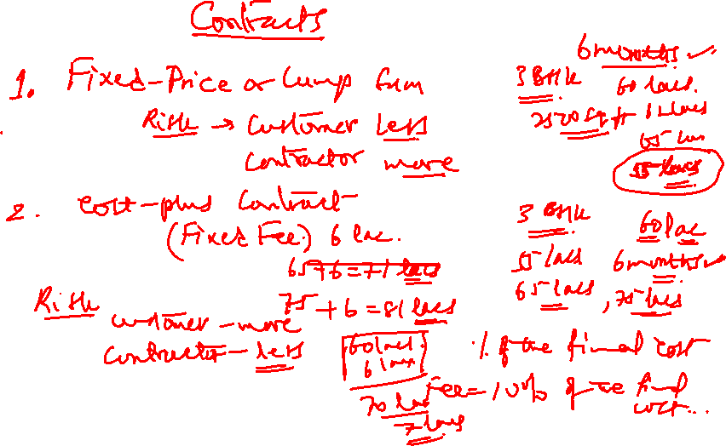

Slide 28
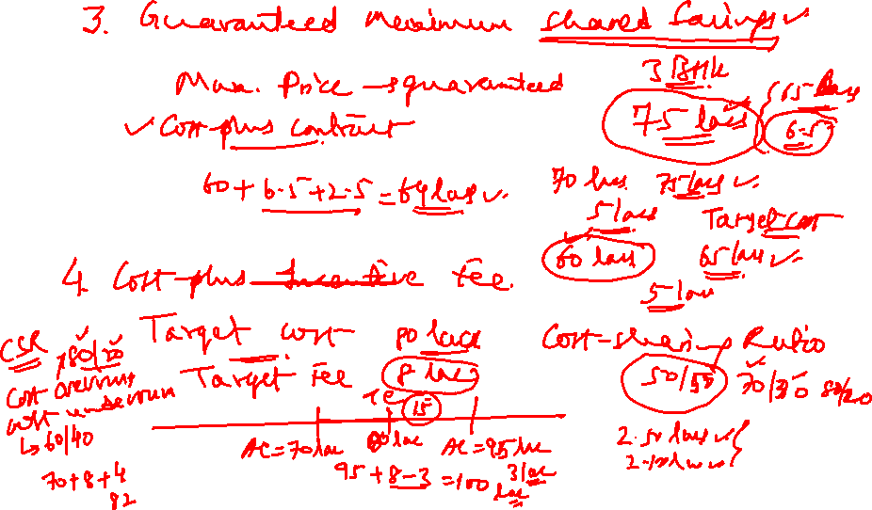

Slide 29


Slide 30
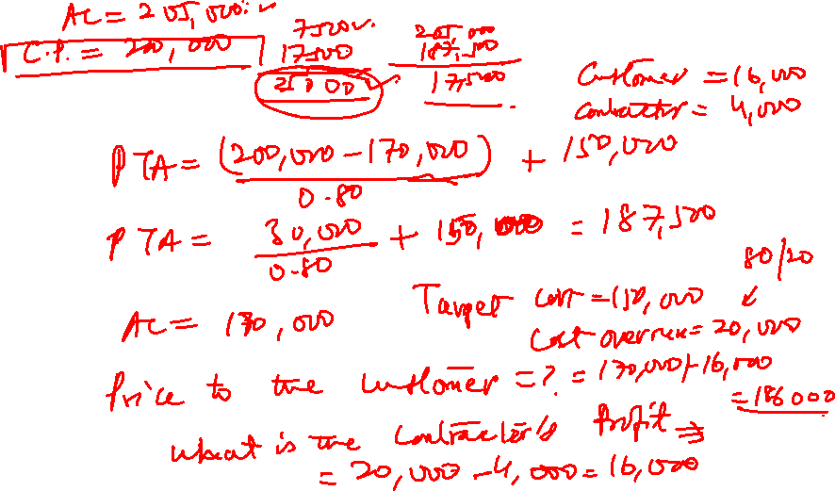

Slide 31
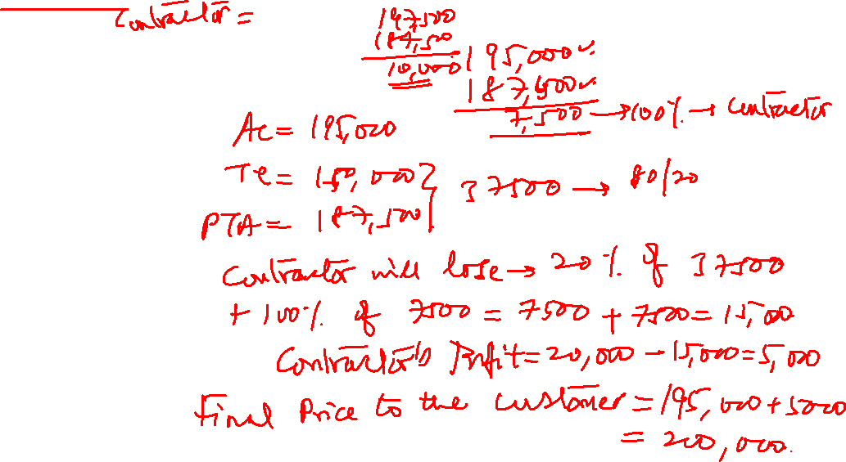

Slide 32
Project Audit
Project Closure

Slide 33

Project Closure
Project Audit and Closure
Project Audit
Project Closure
Types of Project Closure
Wrap-Up Closure Activities
Post-Implementation Evaluation
Retrospectives

Slide 34
Project Audit
In recent years, the necessity for a structured independent review of various parts of a business, including projects, has taken on a more important role. These independent reviews are audits that focus on either discovery or decision-making. The audits can be scheduled or random and can be performed by in-house personnel or external examiners.
Project audit is the process of verification of the extent to which the project realization complied with the rules and principles of project management for the project.

Slide 35
Project Audit
The main goal of an audit is to:
Inspect and evaluate the current state of project realization,
Find out to what extent it complied with defined criteria for project success, and
Identify opportunities for improving the project realization and management.
This inspection can be performed after the project completion or after the end of one project realization stage, or it can be performed during the project realization.

Slide 36

Project Audit
Types of Audit
● Performance Audits: These audits are used to appraise the progress and performance of a given project. The project manager, project sponsor, or an executive steering committee can conduct this audit.
● Compliance Audits: These audits are usually performed by the project management office (PMO) to validate that the project is using the project management methodology properly. Usually the PMO has the authority to perform the audit but may not have the authority to enforce compliance.

Slide 37

Project Audit
● Quality Audits: These audits ensure that the planned project quality is being met and that all laws and regulations are being followed. The quality assurance group performs this audit.
● Exit Audits: These audits are usually for projects that are in trouble and may need to be terminated. Personnel external to the project, such as an exit champion or an
executive steering committee, conduct the audits.

Slide 38
Project Audit
● Best Practices Audits: These audits can be conducted at the end of each life-cycle phase or at the end of the project. Some companies have found that project managers may not be the best individuals to perform the audit. In such situations, the company may have professional facilitators trained in conducting best practices reviews.

Slide 39
Project Closure
Carefully managing the closure phase is as important as any other phase of the project.
In today’s project driven organizations that have many projects occurring simultaneously, the responsibility
for completing closure tasks has been parsed among the project manager, project teams, project office, an oversight “review committee,” and an independent retrospectives facilitator.
Many tasks overlap, occur simultaneously, and require coordination and cooperation among these stakeholders.

Slide 40
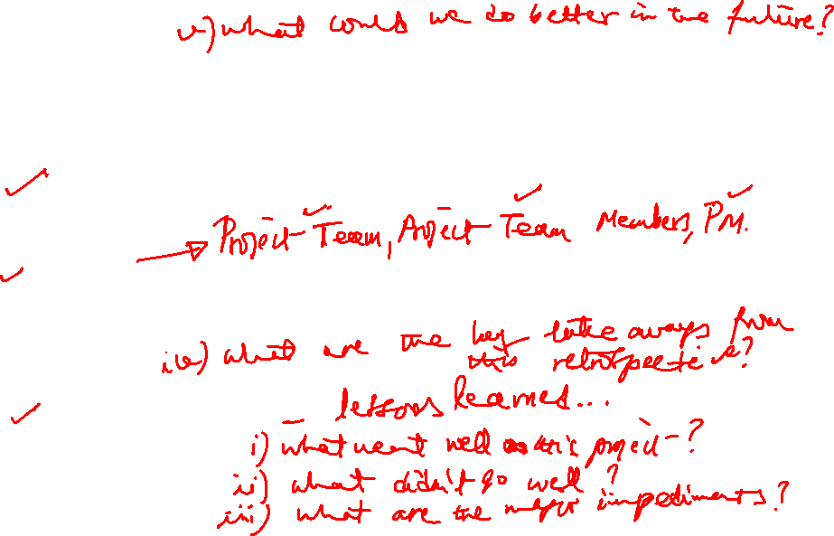
Project Closure
The three major deliverables for project closure are:
Wrapping up the project.
Evaluation of performance and management of the project.
3. Retrospectives.

Slide 41

Project Closure
Types of Project Closure
Normal The most common circumstance for project closure is simply a completed project.
Premature For a few projects, the project may be completed early with some parts of the project eliminated.

Slide 42

Project Closure
Perpetual Some projects never seem to end.
The major characteristic of this kind of project is constant “add-ons”, suggesting a poorly conceived project scope.
Failed Project Failed projects are usually easy to identify and easy for a review group to close down.
Changed Priority Organizations’ priorities often change and strategy shifts directions.

Slide 43

Project Closure
Wrap-Up Closure Activities
Implementing the closure process includes the following six major wrap-up activities:
1. Getting delivery acceptance from the customer.
2. Shutting down facilities and releasing resources to new uses.
3. Reassigning project team members.
4. Clearing all invoices and closing accounts.
5. Delivering the product to the customer.
6. Submitting a final project report.

Slide 44
Project Closure
Many organizations develop lengthy lists for closing projects to ensure nothing is left out.
Most organizations have checklists of a large number of wrap-up tasks!
These checklists deal with closure details such as facilities, teams, staff, customer, vendors, and the project itself.
A partial administrative closure checklist is shown on the next page.

Slide 45
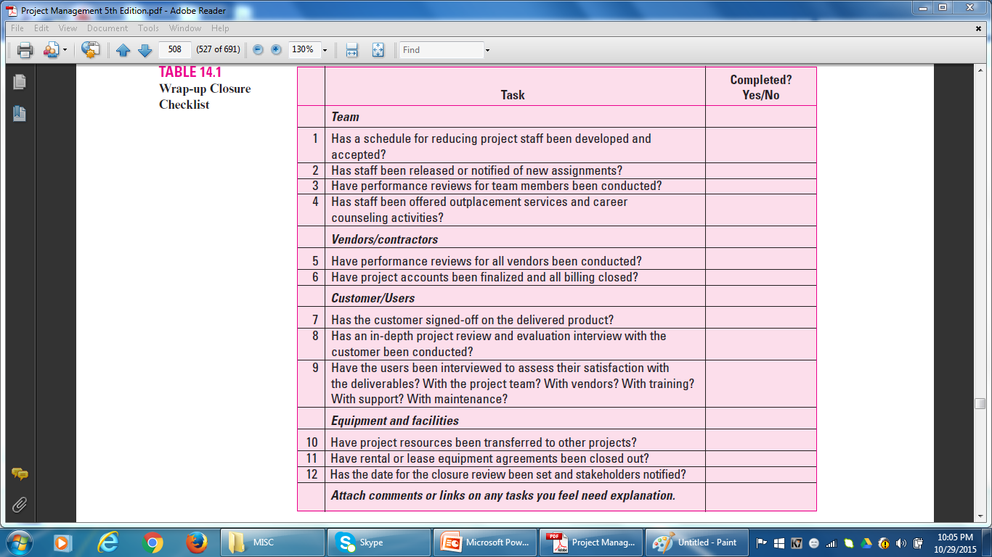

Project Closure

Slide 46

Project Closure
Creating the Final Report
The final project report summarizes project performance and provides useful information for continuous improvement.
The content of the final report typically includes the following topics:
Executive Summary,
Review and Analysis,
Recommendations,
Lessons Learned, and
Appendix.

Slide 47

Project Closure
Post-Implementation Evaluation
The purpose of an audit of a completed project is to assess how well the following performed during project realization:
Project Team
Team Members
Project Manager

Slide 48

Project Closure
Retrospectives of Lessons Learned
Lessons learned represent an analysis carried out during and shortly after the project life cycle; they attempt to capture positive and negative project learning. That is, “what worked and what didn’t?”
Barriers to effectively mining the lessons learned are:
• The most common reason given for not creating lessons learned is lack of time.

Slide 49

Project Closure
• Most lessons learned are captured when the project is complete; teams get little direction or support after the lessons are reported.
Lessons learned often degenerate into blame sessions that became emotionally damaging.
• Lessons learned are not being used across different locations.
• Lessons learned while implementing the project are seldom used to improve the remaining work in the project.
• Too often the lessons learned are not used in future projects because the organizational culture fails to recognize the value of learning.

Slide 50

Project Closure
A retrospective is a methodology that analyzes a past project event to determine what worked and what didn’t,
develops lessons learned, and creates an action plan that ensures lessons learned are used to improve management of future projects.
The major goals of retrospectives are to reuse solutions and stop repetitive mistakes across the organization.

Slide 51

Project Closure
Retrospectives methodology has several characteristics
to ensure its effectiveness and value:
• Uses an independent facilitator.
• Includes a minimum of three in-process learning gates during the project life cycle.
• Has an owner.
• Develops a repository that is easy to use.
• Mandates a discipline that ensures retrospectives are used.

Slide 52

Project Closure
Initiating the Retrospective Review
In some organizations, review initiation comes from a formal project review group or can be automatic.
For example, in the latter case, all projects are reviewed at specific
stages in the project life cycle—perhaps when a project is 10 to 20 percent complete in time or money, 50 percent complete, and after completion.
In most other multi-project organizations, reviews (called stage gates) are planned for the completion of major milestones. The review is not linked to percent complete. Milestones are binary; either you have reached requirements completion or you have not.
Regardless of how reviews are set up, they should be set up in the project planning stage—before the project begins.

Slide 53

Project Closure
Use of an Independent Facilitator
The retrospective methodology uses an independent facilitator to collect and implement lessons learned to improve management of current and future projects.
A project facilitator is a guide who leads the project team through an analysis of project activities that went well, what needs improvement, and development of a follow-up action plan with goals and accountability.
Characteristics of a Facilitator
Roles of a Facilitator

Slide 54

Project Closure
Managing a Retrospective
Having a facilitator available at the start of a project is preferred. The retrospective approach stresses gathering lessons learned during project execution and using them to change remaining work. Experience tells us memories fade as time passes; people leave the project. If lessons learned are not captured early, they may be lost. Catching lessons midway in the project life cycle allows for changing the way the remaining work is performed.

Slide 55

Project Closure
Most retrospective methods use a minimum of three gates during the project life cycle to collect lessons learned that can be used to self correct the remainder of project execution.
It is critical to have a separate repository or library where reports and lessons learned are accessible and easy to retrieve. The responsibility for maintaining a repository for lessons learned and encouraging its use is normally the responsibility of the project office or oversight committee.

Slide 56
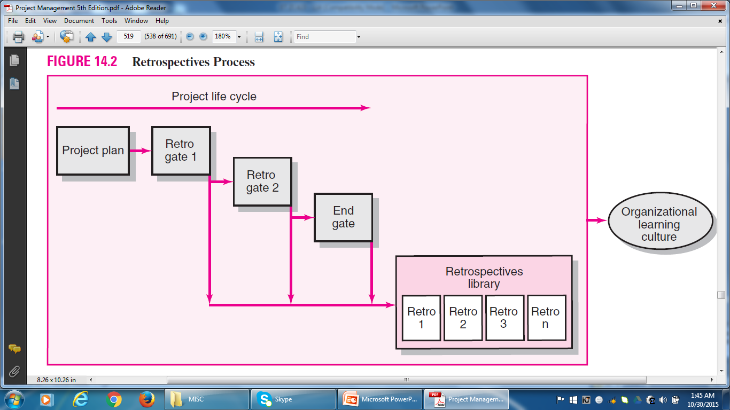

Project Closure

Slide 57
Project Closure
Overseeing a Post-Project Retrospective
In the past, lessons learned were primarily collected from a post-project survey. Someone reviewed the answers, summarized the results, and filed the document.
In retrospective methodology, the facilitator uses several questionnaires as a starting point to conduct the post-project retrospective. These surveys often offer clues to unrecognized deeper problems. A facilitator relates that clues to areas needing improvement are often found by checking the changes running through the project’s change management system. These hard data can point directly to areas that hold potential for improvement. In some cases the data direct the facilitator to the area where a problem was solved.

Slide 58

Project Closure
Process and Methods Review
Process review begins with a review of the strategic intent of the project, selection criteria, project charter, project objectives, project scope, and acceptance criteria.
This starting point reinforces and clarifies the business case for the project and the final project deliverables. Additional data gathering for process review is initiated
through a questionnaire that is distributed to all major project stakeholders for responses.

Slide 59
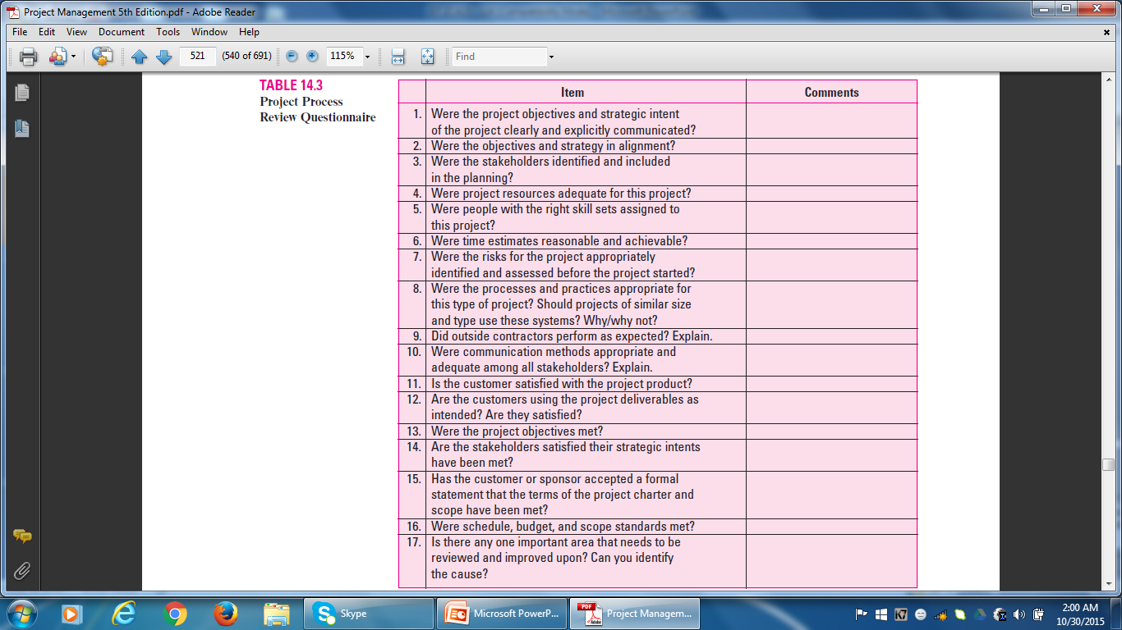
Project Closure

Slide 60

Project Closure
Organizational Review
Project performance is strongly influenced by organizational culture. It is therefore important to assess what fundamental organizational culture properties affect project successes and failures or become a hindrance to project teams.
Again, survey questionnaires are easy, quick, and inexpensive to develop and collect data.

Slide 61
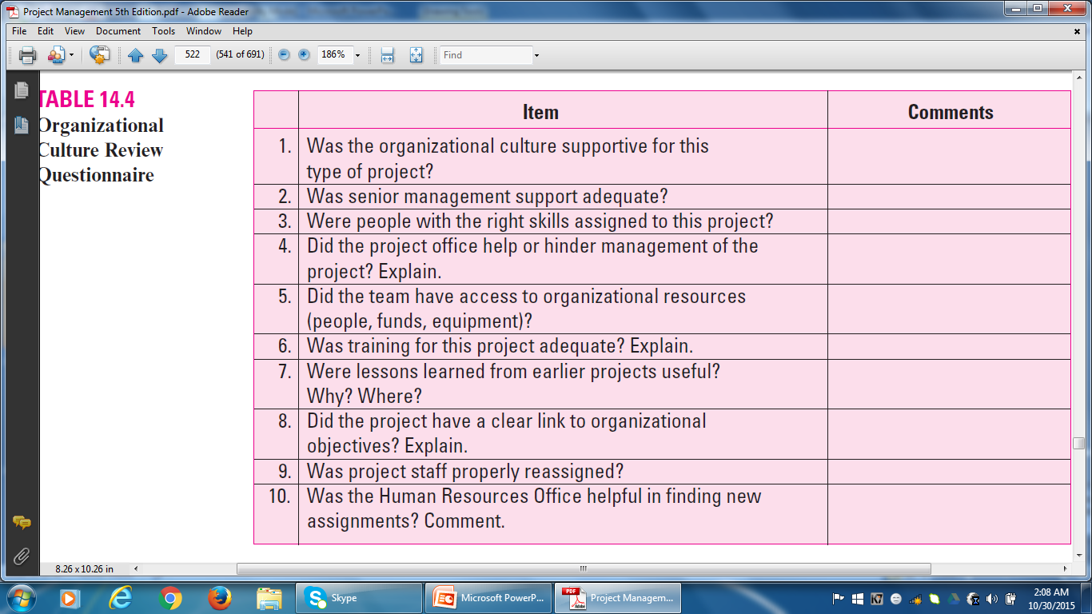
Project Closure

Slide 62

Project Closure
Facilitator Tasks:
Collects survey info – one-on-one interaction with project team members, the PM, and other stakeholders.
Leads team retrospective session – to have consensus on key retrospectives; decide on action plan for improving future projects.
Additional task – review of archived lessons.

Slide 63

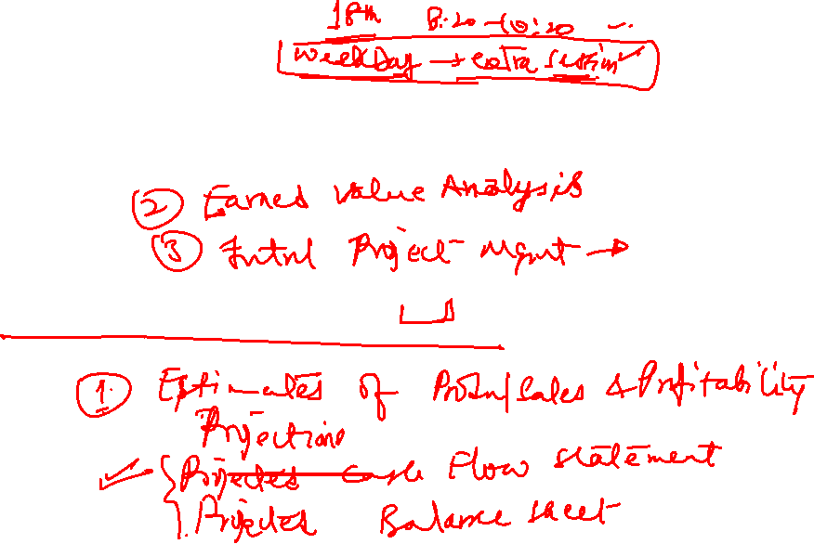
Project Closure
Utilization of Retrospectives
Archiving Retrospectives

Slide 64
Project Management
Thank You!

